Slide 1






PDS
Computer Vision
Cloud Architecture
@ P. Siagian
https://github.com/siagianp
https://www.youtube.com/@AmelOline/videos
https://github.com/amelcharolinesgn2/IoT_simulator-mqtt-NodeRed
https://github.com/amelcharolinesgn2/Cloud-Infrastructures
https://github.com/amelcharolinesgn2/ClouD-Infrastructure-SISKA-2025
https://github.com/amelcharolinesgn2/Gyroscope-Sensor-Data-Accelerometer
https://github.com/amelcharolinesgn2/cloudSim
https://github.com/amelcharolinesgn2/CloudSim
Notes:
data communication simulator
https://github.com/yetanalytics/datasim
Quantum Communication Simulator
https://github.com/Slygriyrsk/quantum-communication-simulator
MIL-STD-1553-Simulator
MIL-STD-1553 is a serial communication protocol that is used in spacecrafts for internal communication. A spacecraft consists of various components like main computer, star tracker, fly wheel, temperature sensor, cameras (also called as Remote Terminals) etc. The main computer needs to communicate with all the other peripherals to get the data and send it to ground station for further processing. This internal communication is done by a serial bus called MIL-STD-1553. This repository contains a simulation for this protocol. It can be used to create any space applications by importing the simulator into your code.
MIL-STD-1553 has Bus Controller that orchestrates the transmission and reception of data on the serial bus. It always initiates the communication and commands Remote Terminal for sending or receiving data. Only one node or Remote Terminal can send data on the bus at a given moment when ordered by the Bus Controller. The details of the protocol can be found in MIL-STD-1553 Tutorial and Reference document by Alta dt.
About This Repository:
This repository segregated based on various components that are described in the MIL-STD-1553 standard. Two of the most important components are Bus Controller and Remote Terminals. For a small network, one serial bus can handle up to 31 remote terminals and one bus controller. This repository is divided into two parts. Bus Controller Simulator and Remote Terminal Simulator. Both the components have separate set of functionalities.
Bus Controller Simulator : This simulator is responsible to understand the requirements from the Flight Software or Spacecraft computer and send commands and data to Remote Terminal.
Remote Terminal Simulator : This simulator is responsible for understanding the commands or data comming from the Bus Controller and send status and data based on the requirements sent by the Bus Controller.
How To Use This Simulator
https://github.com/ShubhankarKulkarni/MIL-STD-1553-Simulator
This simulator uses ethernet communication instead of the actual physical communication that is mentioned in the standars. The standard is developed taking harsh and noisy conditions into account. The simulator majorly focuses on data layer of the standard. Based on this, you can either deploy both the simulators on the same machine and test it over the local loopback or you can deploy separate simulators on separate machines in a single subnet or same network.
You can run the following commands to run the simulators
python BC_Simulator.py
python RT_Simulator.py
python Simulator.py
Or you can uncomment a section of code in Simulator.py that creates threads for Bus Controller Simulator and Remote Terminal Simulator and then run the following command
python Simulator.py
Simulator.py only provides an example of how you can use BC and RT simulators. You can replace Simulator.py by any space application that needs to transfer any data using MIL-STD-1553. Apart from that, this whole repository is developed as a module. So, you can simply clone the repository into your application and can import it.
Arikatakur/Network-Transmission-Simulator
https://github.com/Arikatakur/Network-Transmission-Simulator
imulates network data transmission using the Stop-and-Wait protocol with acknowledgment packets. It includes:
Theoretical Calculator: Computes the time required to send a file under ideal conditions.
UDP File Transfer Tools: Sends files over a network using UDP and logs transmission details.
Experimentation Framework: Measures and compares theoretical vs. actual transmission times.
Features
Command-line interface for both theoretical calculations and actual file transmission.
Logs packet transmission details, acknowledgments, and final results.
Javadoc documentation for all classes and methods.
Test cases for robust verification.
Requirements
Java Development Kit (JDK) version 8 or higher.
Two computers on the same network for experimentation.
Tools:
iperf for bandwidth measurement.
Wireshark for packet analysis.
Design of data communication networks using simulation techniques
A Simulator for FANETs Using 5G Vehicle-to-Everything Communications and Named-Data Networking
https://arxiv.org/html/2510.13823v1

Slide 2
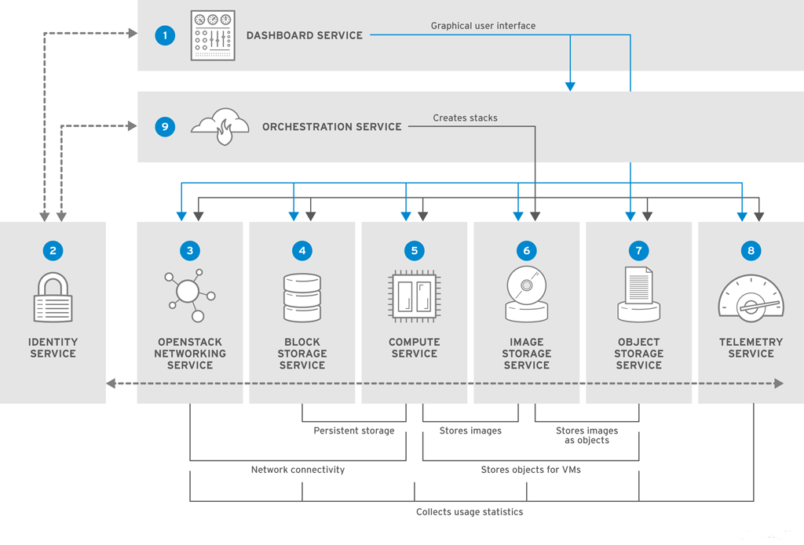
OpenStack
Nova (Compute / Instance)
Neutron (Networking / Jaringan)
Keystone (Identity / User & Project)
Cinder (Block Storage / Volume)
Glance (Image / OS)

Slide 3
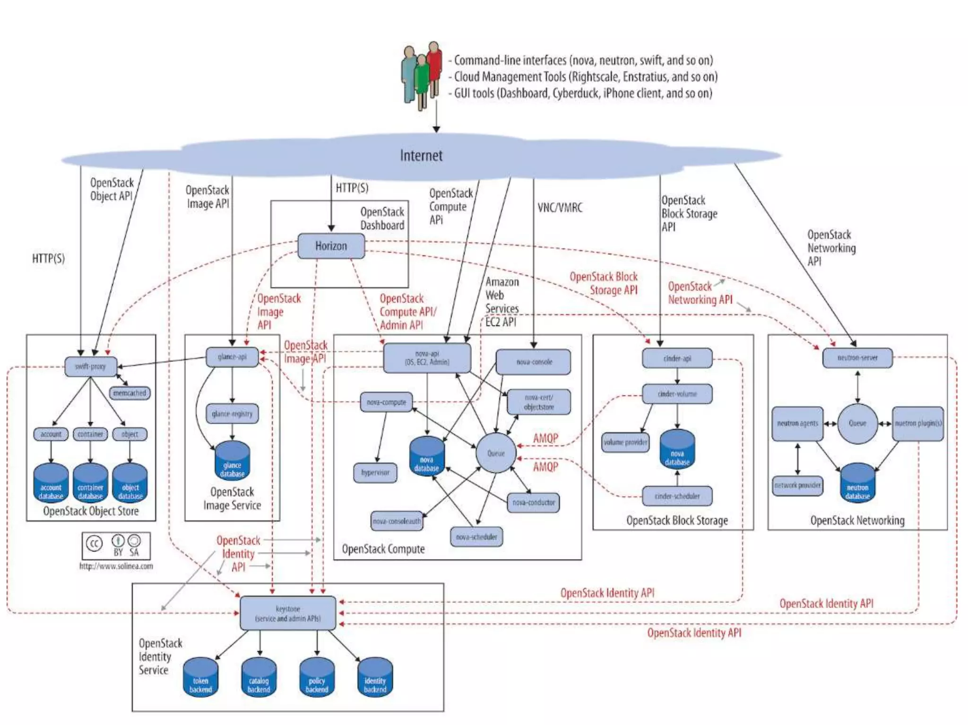

Slide 4
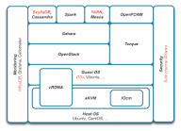
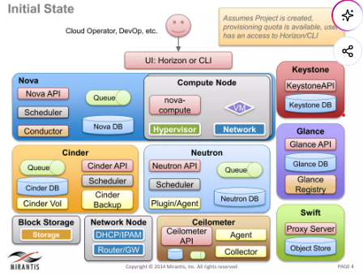
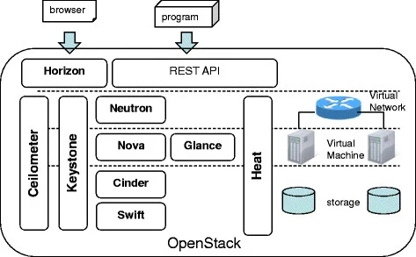

Slide 5
OpenStack uses a modular design where different services work together through APIs:
💾 Block Storage (Cinder)
The cinder database handles persistent block storage volumes.
volumes: Contains volume sizes, statuses, and attachment information.
volume_attachment: Maps volumes to the respective Nova instances.
snapshots: Stores point-in-time copies of volumes.
Nova (Compute): Manages and provisions virtual machine instances.
Neutron (Networking): Provides pluggable, scalable networking and IP management.
Cinder (Block Storage): Delivers persistent block storage devices for virtual servers.
Swift (Object Storage): Handles unstructured data and object storage for backups and media.
Glance (Image Service): Stores and catalogs disk and server images.
Keystone (Identity Service): Manages user authentication, tokens, and access policies. [1]
🖼️ Image Service (Glance)
The glance database manages virtual machine images.
images: Stores image metadata (name, size, disk format, container format).
image_properties: Custom key-value pairs assigned to images for advanced scheduling.
💻 Compute Service (Nova)
The nova database tracks instances, hypervisors, and compute resources.
instances: Stores the virtual machine details (UUID, host, power state, architecture).
instance_types: Contains information about available flavors (RAM, VCPUs, disk space).
compute_nodes: Details the physical hypervisors running the instances.
block_device_mapping: Maps volumes and images attached to specific instances.
🔑 Identity Service (Keystone)
The keystone database manages authentication and authorization.
user: Stores cloud user accounts and credentials.
project (or tenant): Lists isolated resource containers/tenants.
role: Defines access permissions assigned to users within projects.
🌐 Networking Service (Neutron)
The neutron database manages virtual network topologies.
networks: Lists the virtual networks created in the cloud.
ports: Tracks virtual switch ports where instances connect.
subnets: Stores IP address blocks assigned to networks.
securitygroups: Defines the firewall rules assigned to ports or projects.

Slide 6
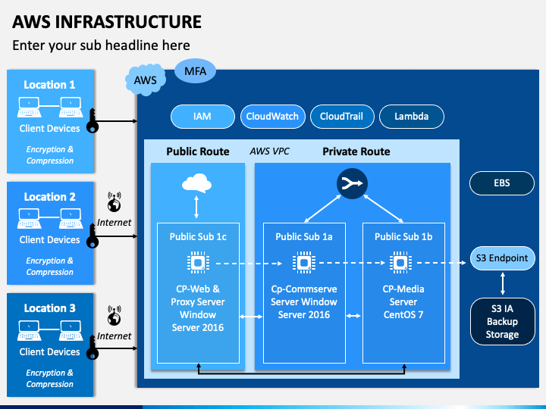
AWS
Core AWS Services Categories
Compute: Includes EC2 (virtual servers), Lambda (serverless code execution), and ECS/EKS for container management.
Storage: Offers S3 (scalable object storage), EBS (block storage), and EFS (file storage).
Databases: Features RDS (relational databases), DynamoDB (NoSQL), and Redshift (data warehousing).
Networking & Content Delivery: Handled by VPC (isolated networks), CloudFront (CDN), and Route 53 (DNS).
Security & Identity: Managed via IAM (access control), WAF, and Shield.
Notes:
how to configure and install Compute: Includes EC2, ECS/EKS for container management

Slide 7
AWS Management Console
Log in to your AWS Management Console.
Search for and select S3 in the services search bar.
Click the Create bucket button.
Enter a Bucket name (must be globally unique across all AWS accounts) and select your preferred AWS Region.
Configure your settings (e.g., keep "Block all public access" turned on for security).
Click Create bucket at the bottom of the page. You can now drag and drop files to upload objects directly through your browser.
Installing and Configuring the AWS CLI (For Automation/Terminal)
Install the AWS CLI:
Windows: Download and run the official AWS CLI MSI installer.
macOS: Run curl "https://amazonaws.com" -o "AWSCLIV2.pkg" and install it.
Linux: Run sudo apt install awscli (for Ubuntu/Debian) or use the official bundled installer.
Configure your Credentials:
Open your terminal or command prompt and type:
bashaws configure

Slide 8
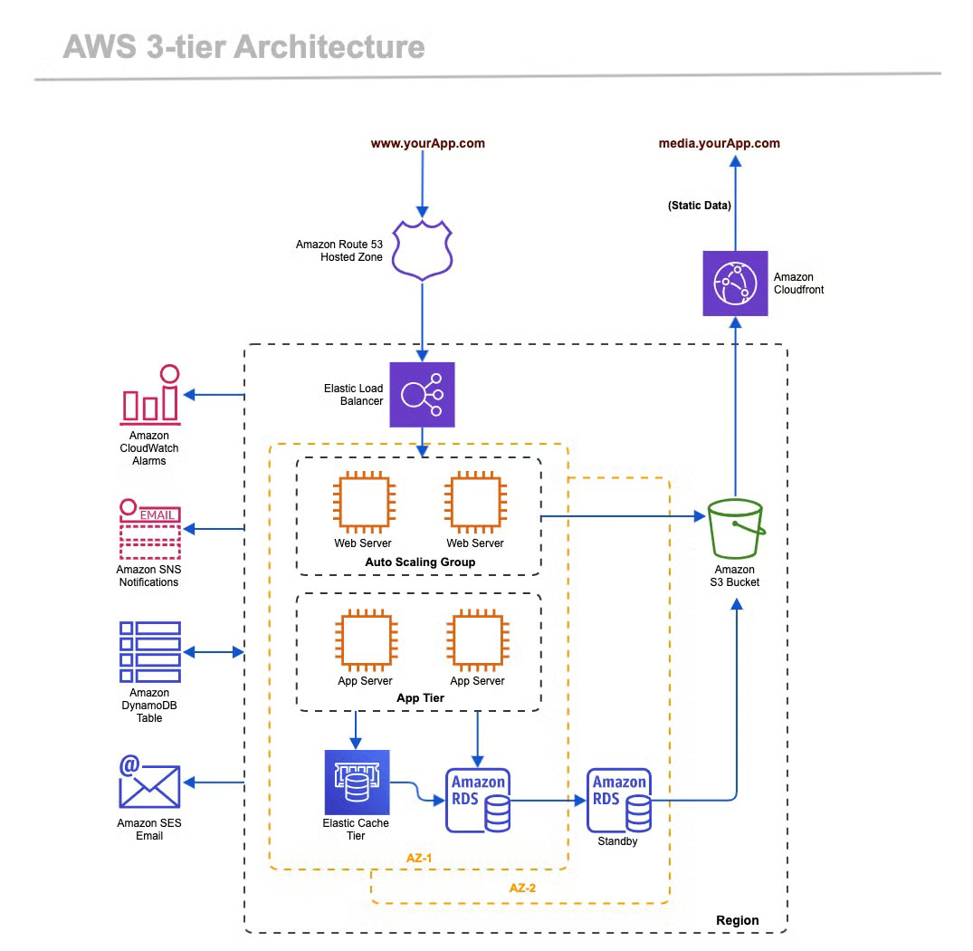
AWS CLI (Untuk Manajemen Umum EC2 & ECS)
Infrastructure as Code (IaC):
Manajemen komputasi serta kontainer di AWS (EC2, ECS, dan EKS)
Konfigurasi Awal: Jalankan perintah aws configure di terminal Anda dan masukkan AWS Access Key ID, Secret Access Key, serta Default Region
eksctl & kubectl (Khusus untuk Manajemen EKS / Kubernetes)
eksctl: CLI resmi dari AWS untuk membuat dan mengelola klaster EKS secara instan.
kubectl: Alat standar untuk menjalankan perintah pada klaster Kubernetes.
Notes:
how to configure and install Compute: Includes EC2, ECS/EKS for container management
how to configure and install Storage: Offers S3

Slide 9
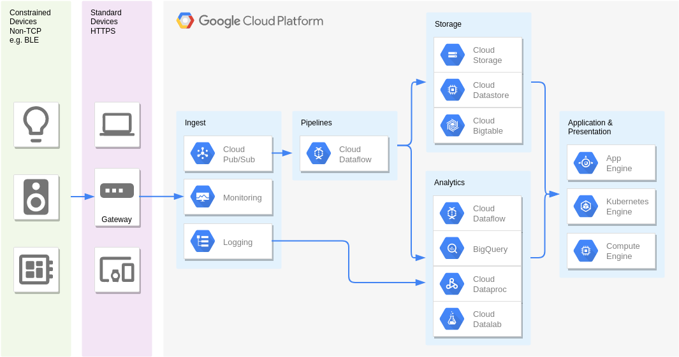
GCP
Compute Engine Client Library
!pip install google-cloud-compute
python
from google.cloud import compute_v1 def list_instances(project_id, zone): instance_client = compute_v1.InstancesClient() request = compute_v1.ListInstancesRequest(project=project_id, zone=zone) for instance in instance_client.list(request=request): print(f"Instance Name: {instance.name}")

Slide 10
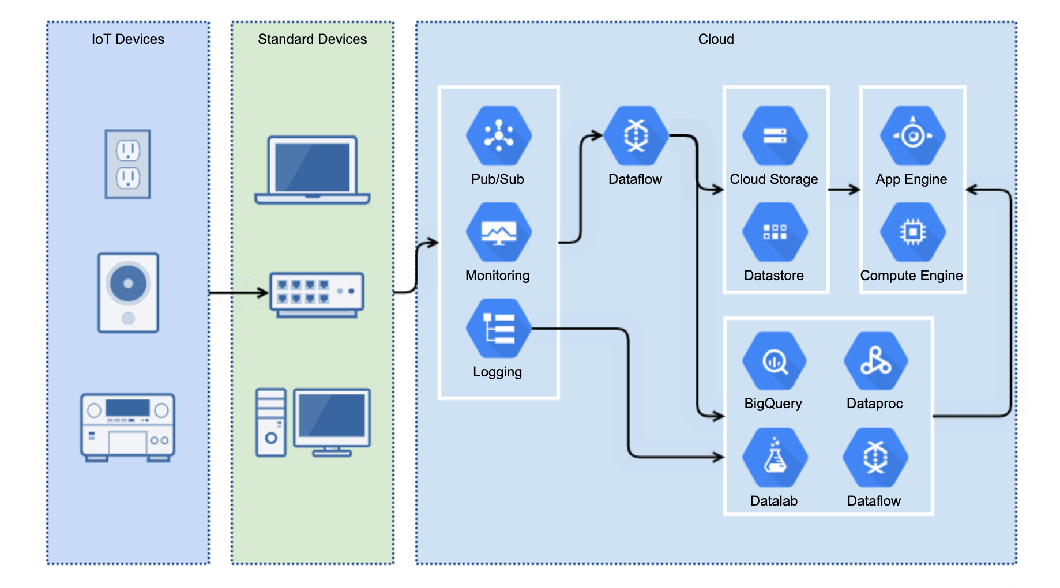
GCP IoT Device
Notes:
how to configure and install Cloud Storage on GCP

Slide 11
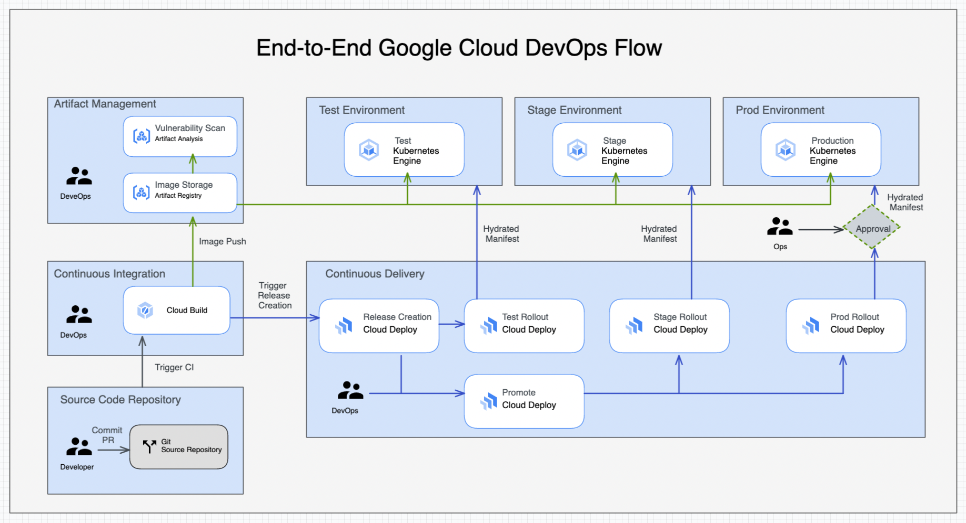
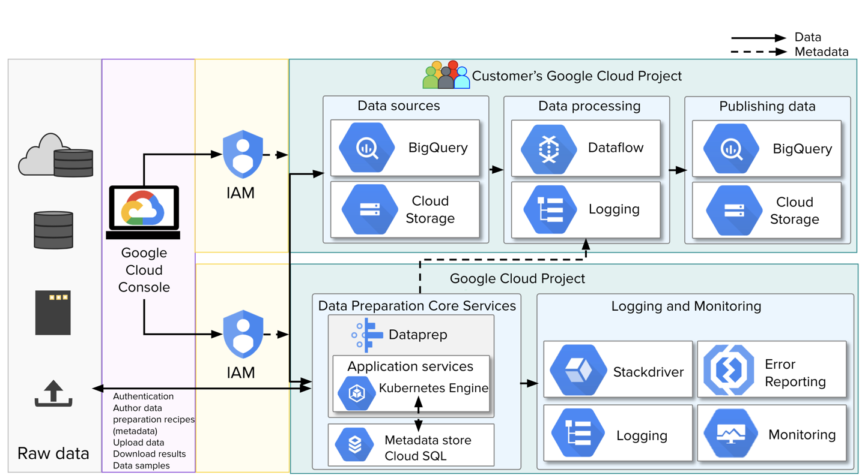

Slide 12
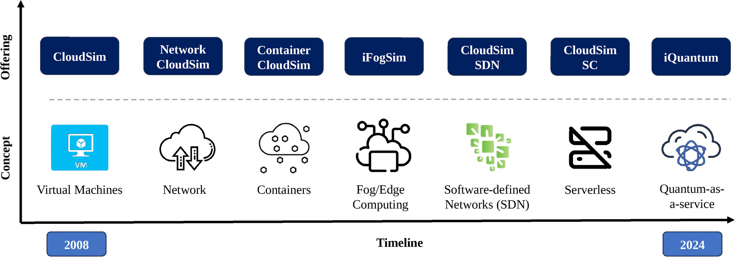
Others
Azure, Alibaba, Amazone
Fig.1. The evolution of CloudSim.

Slide 13
Submit Week 3
HW_Cloud Architecture Cont't_Introduction to Cloud Computing.pptx
https://github.com/amelcharolinesgn2/CloudSim/
Uraikan Keuntungan dan kerugian dilakukan Migrasi Server dan buat arsitektur sebelum dan sesudah?
Uraikan arsitektur dan fungsional : Microservice & Monolithic Application ?
Uraikan konsep, arsitektur Virtualisasi ?
Kenapa Cloud Computing ? (Konsep, Arsitektur, Library, Setup)
Uraikan Perbedaan arsitektur dan library yang di pergunakan ?
Uraikan tugas secara fungsional dari masing-masing komponen pada Gambar 1. The evolution of CloudSim.
Uraikan konsep, arsitektur iQuantum dan Quantum as a service ?
HW setiap mahasiswa kirim ke GDrive sendiri
Ketua Kelas Buat file exel : link gDrive untuk tugas dan project
NamaFile: HW1-Nama_NIM– Introduction Cloud.docx

Slide 14
Submit Week 4
Uraikan konsep, arsitektur : 02_ CloudSim-Simulation Of Cloud Computing Infrastructures.docx
https://github.com/Cloudslab/cloudsim
Notes: Boleh menggunakan tools dan library lain
HW setiap mahasiswa kirim ke GDrive sendiri
Ketua Kelas Buat file exel : link gDrive untuk tugas dan project
NamaFile: HW2-Nama_NIM–CloudSimulator.docx

